Slide 1

Network Layer: Subnetting
Lecture 8 | CSE421 – Computer Networks
Department of Computer Science and Engineering School of Data & Science

Slide 2
Objectives
Subnetting
VLSM
Binary Calculation
Base 256 Calculation

Slide 3
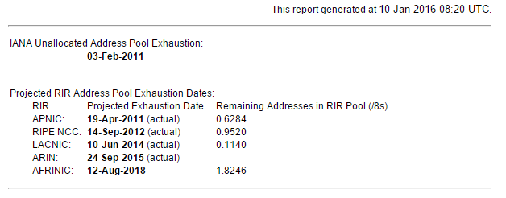
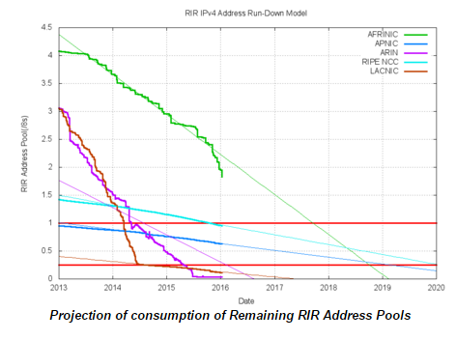
IPv4 Address Exhaustion

Slide 4
Solutions
Long term:
Change to IP version 6.
Plenty of addresses using a different scheme
Short term:
Use Subnetting (VLSM & CIDR) to avoid wasting addresses
Use private addresses locally and NAT for internet access – lets many host share a few public addresses
DHCP!

Slide 5
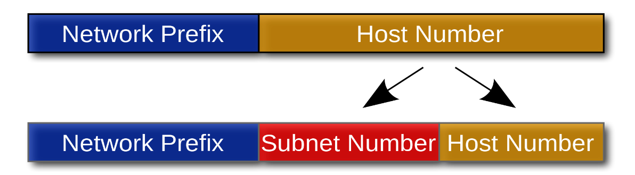
Subnetting
The strategy used to partition a single physical network into more than one smaller logical sub-networks (subnets).
Subnets are designed by accepting bits from the IP address's host part and using these bits to assign a number of smaller sub-networks inside the original network.
Allows an organization to add sub-networks without the need to acquire a new network number via the Internet service provider (ISP).

Slide 6
Subnetting
Three methods of subnetting
Classful IP Addressing
Fixed Length Subnet Masking
Variable Length Masking
Goal
Assign a block of IP addresses to fulfill the total needs of a network
A network has 200 hosts per say, give them a network address which can support 200 hosts!
Give them the smallest block possible to waste least of the IP addresses but not below 200!
**Note: You can assign blocks of size 2^{N} only. This is because the number of bits assigned to host from an IP address cannot be partial, number of bits is discrete and must be an integer value. (Can you assign 1.5 bits to host and 30.5 bits to network?)

Slide 7
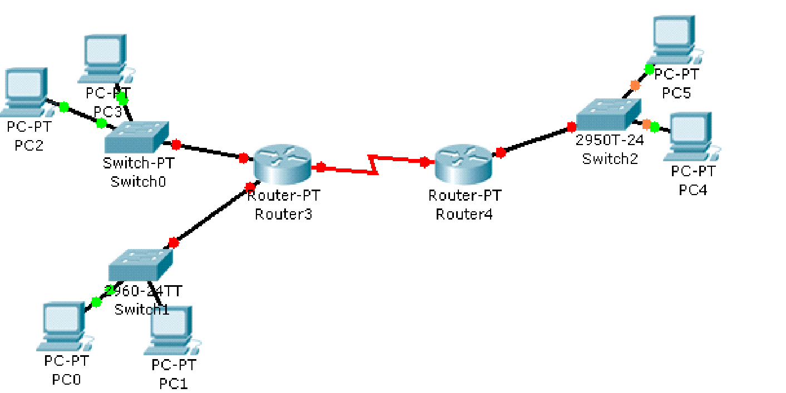
Fixed length subnetting
All subnets of a main network must have the same subnet mask.
This means that they must all have the same number of hosts.
Example
How many network addresses do you need for the organization?
How many network addresses do you have?
How many bits do you have for hosts?
How many host bits do you need to borrow to create the number of sub networks that you need?
Khulna Branch
120 Hosts
Banani Branch
15 Hosts
Motijheel Branch
30 Hosts

Slide 8
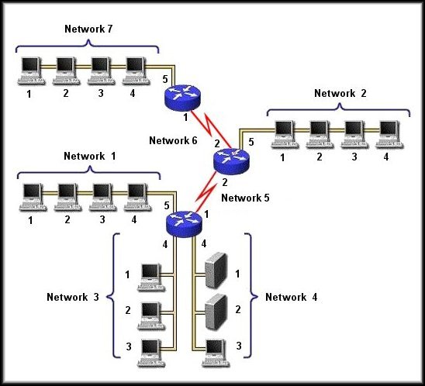
Fixed Length Subnetting: Example
192.168.80.192/27
192.168.80.0/24
192.168.80.32/27
192.168.80.160/27
192.168.80.0/27
192.168.80.128/27
192.168.80.64/27
192.168.80.96/27

Slide 9
VLSM
Also known as “Variable Length Subnet Masking”
Always satisfy the requirements of your biggest LAN and then work your way down to the smallest LAN.
Assign a block of IP satisfying only that particular LAN.
200 hosts? Assign a block of size 256 IPs!
1000 hosts? Assign a block of size 1024 IPs!
2 Hosts? Assign a block of size 2 IPs!

Slide 10
Comparison of Subnetting
Given the network 192.168.1.0/24.
Subnet this to two hosts of size 120 (Network A) and 3 (Network B)
So, Network A needs 122 IPs and Network B needs 5 IPs.
Classful IP Addressing |  | Fixed Length Subnet Masking |  | Variable Length Subnet Masking (VLSM)/CIDR
Network A: Subnet; Class C: Waste: 254 – 122 | 122 -254 132 | Network A: Subnet Size(2⁷): Waste: 128 – 122 | 122 -128 6 | Network A: Subnet Size(2⁷): Waste: 128 – 122 | 122 -128 6
Network B: Subnet; Class C: Waste: 254 – 5 | 5 -254 249 | Network B: Subnet Size(2⁷): Waste: 128 – 5 | 5 -128 123 | Network B: Subnet Size(2³): Waste: 128 – 5 | 5 -8 3
Total Waste: | 381 | Total Waste: | 129 | Total Waste: | 9
**Total Waste = Waste_{Network A} + Waste_{Network B}
**Waste_{Network Y} = Subnet Size_{Network Y} – Network Y_{Host}

Slide 11
Comparison of Subnetting
Given the network 192.168.1.0/24.
Subnet this to two hosts of size 120 (Network A) and 3 (Network B)
So, Network A needs 122 IPs and Network B needs 5 IPs.
Classful IP Addressing
Fixed Length Subnet
Variable Length Subnet
Masking
Masking (VLSM)/CIDR
Network A:
122
Network A:
122
Network A:
122
Subnet; Class C:
-
7
256
Subnet Size(2
):
-
128
Subnet Size(2
):
-
7
128
Waste: 254
–
122
134
Waste: 128
–
122
6
Waste: 128
–
122
6
Network B:
5
Network B:
5
Network B:
5
Subnet; Class C:
-
7
3
256
Subnet Size(2
):
-
128
Subnet Size(2
):
-
8
Waste: 254
–
5
251
Waste: 128
–
5
123
Waste: 128
–
5
3
Total Waste:
385
Total Waste:
129
Total Waste:
9
**Total Waste = Waste_{Network A} + Waste_{Network B}
**Waste_{Network Y} = Subnet Size_{Network Y} – Network Y_{Host}

Slide 12
Lots of Waste!
Waste:
Classful subnetting wastes addresses.
If you are using private addresses then you may not be bothered.
Waste of public addresses does matter.
Solutions:
Variable Length Subnet Masking (VLSM)
Create subnets as per specific host requirements.

Slide 13
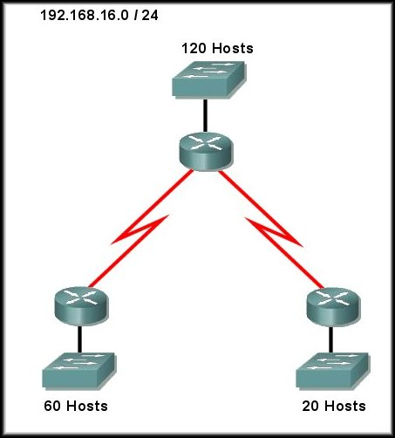
VLSM Example 1

Slide 14
VLSM Example 1
Network address given: 192.168.16.0/24
Host requirements (sorted largest to smallest)
LAN 1: 120 Hosts
LAN 2: 60 Hosts
LAN 3: 20 Hosts
WAN 1: 2 Hosts
WAN 2: 2 Hosts

Slide 15
VLSM Example 1
Host Name | Host requirement | +2 | IP Block size | Host bits required | Network bits required
A | 120 | 122 | 128 | 7 | 25
B | 60 | 62 | 64 | 6 | 26
C | 20 | 22 | 32 | 5 | 27
D | 2 | 4 | 4 | 2 | 30
E | 2 | 4 | 4 | 2 | 30

Slide 16
VLSM Example 1
Host Name
Host
+2
IP Block size
Host bits
Network bits
requirement
required
required
A
120
122
128
7
25
B
60
62
64
6
26
C
20
22
32
5
27
D
2
4
4
2
30
E
2
4
4
2
30

Slide 17
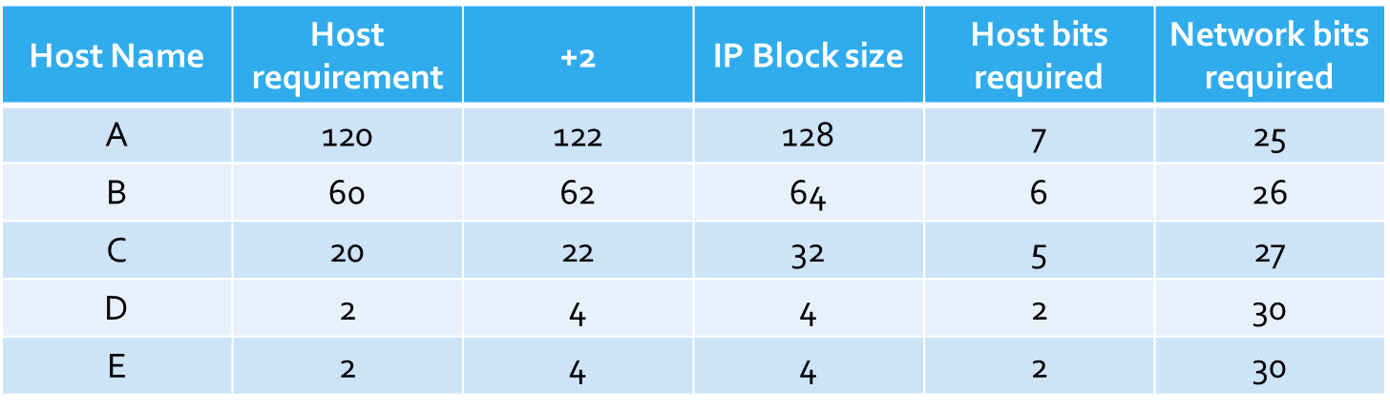
VLSM Example 1
Given network address
192.168.16.0/24
192.168.16.0/25
192.168.16.128/25
192.168.16.128/26
192.168.16.192/26
192.168.16.192/27
192.168.16.224/27
192.168.16.224/30
192.168.16.228/30

Slide 18
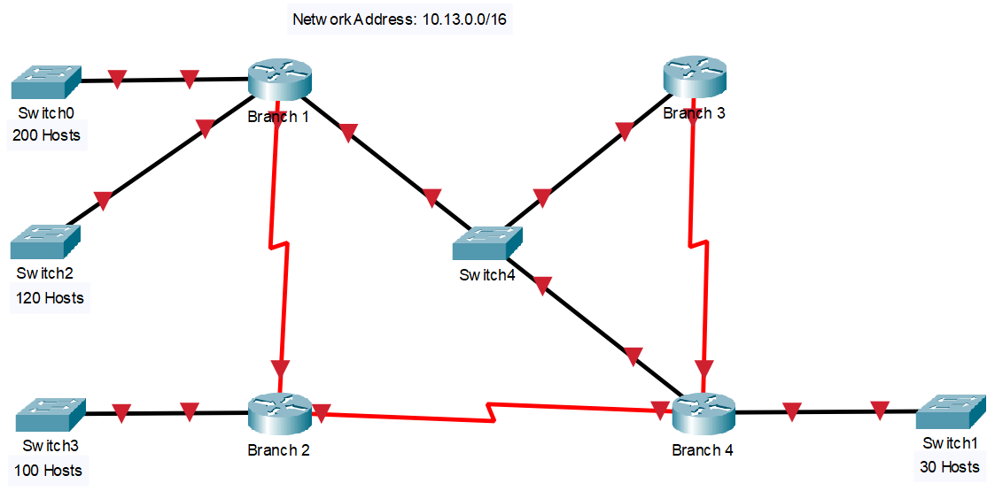
VLSM Example 2
4 LANs
3 WANs
1 Switched Network

Slide 19
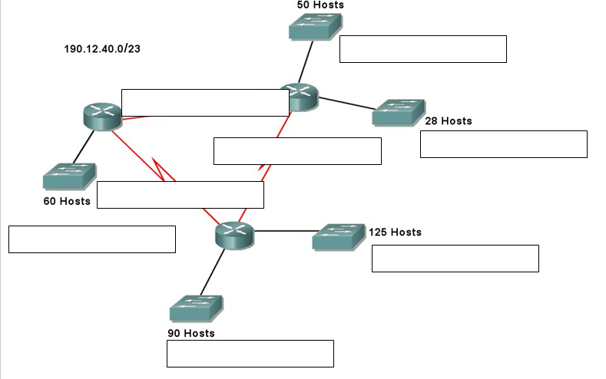
VLSM-Exercise # 2
How many LANs?
How many WAN Links?
- 5 LANs
- 3 WAN Links

Slide 20
CIDR Concept
Also known as “Classless Inter-Domain Routing”
To CIDR-compliant routers, address class is meaningless
The network portion of the address is determined by the network subnet mask, also known as the prefix or prefix length (/8, /19, etc.)
Classless routing protocols are complaint with CIDR which means they understand
VLSM and
Route Summarization.
All routing protocols are classless nowadays.

Slide 21
The End

